Slide 1
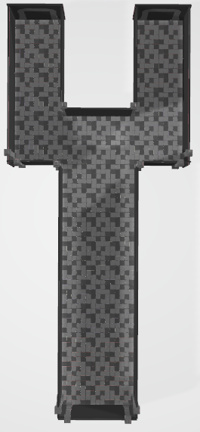
(x, z)
(2000, 1140~800)
(x, z)
(2000, - 200~ -450)
2000, 1140~868
2000, ??
경로1(왼쪽시작)
1 (2000, 1000)
2 (700, 900)
3 (430, 430)
4 (-2400, 500)
경로2(오른쪽시작)
1 (2000, -300)
2 (700, -350)
3 (430, 110)
4 (-2400, 100)
880, 730
880, -130
경로3(왼쪽시작)
1 (2000, 1100)
2 (700, 1000)
3 (430, 530)
4 (-2400, 600)
경로4(오른쪽시작)
1 (2000, -400)
2 (700, -450)
3 (430, 210)
4 (-2400, 200)
400, 1250
400, 730
400, -130
400, -670
-2418, -79
x
z
x
z
X : -2418 ~ 2000
Z : -670 ~ 1253

Slide 2

-2630, 2200
경로1(좌 상단)
1 (-2630, 1850)
2 (-1340, 1800)
3 (-1030, -770)
4 (-180, -720)
5 (-360, 200)
경로2(우 상단)
1 (1500, 1900)
2 (-1000, 1630)
3 (-1030, -770)
4 (-180, -720)
5 (-360, 200)
1400, 2200
-2630, 1850
1500, 1900
-2630, 1600
-1510, 1570
-790, 1545
1400, 1600
-320, 1050
경로3(좌 상단)
1 (-1500, -1850)
2 (900, -1590)
3 (950, 820)
4 (270, 810)
5 (-360, 200)
경로4(우 하단)
1 (2630, -1820)
2 (1300, -1630)
3 (950, 820)
4 (270, 810)
5 (-360, 200)
1430, 1050
320, 690
760, 690
포탈
-360, 200
-820, -630
-360, -630
-1480, -980
250, -970
-1500, -1500
730, -1470
1470, -1470
2600, -1530
-1500, -2100
2600, -2150
z
x

